Slide 1


Legal Training

Slide 2
Agenda
Why Legal?
Practice
Special Draft
Talking Points/Steps
Call Listening
Review of Legal Documents
Intake Form

Slide 3

Why is the Client Receiving Legal Docs?
Creditors still have the right to continue collections attempts in ways to collect the amount owe.
Some creditors may proceed to transmit this by Law Offices for legal way to collect the debt.

Slide 4
Legal Documents Review
Client’s Quickbase
What to look for?
https://clearonedebt.quickbase.com/db/bdp9uwef7?a=dr&rid=236562
Creditor Information/Law Office Associated with
Make sure the previous agent who transferred the call updated Current Creditor Name
Court Date/Response Back Date

Slide 5
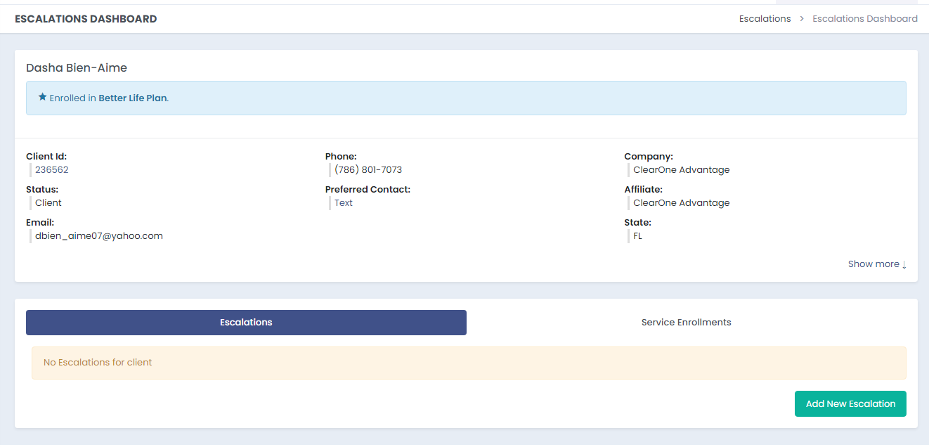
Intake Form
Intake form is need for clients requesting to have specific or Legal accounts to be settled by negotiations.

Slide 6
Intake Form Serving Process
Scenario:
The client calls in because they want us to settle a specific account. If client has an account that has received a summons or gone legal, please follow the Escalation process.
Step 1: Determine if
One of the following are true:
  The client has received a summons, stop and follow steps for legal accounts
  The client is requesting to settle or resettle (We do not charge a resettle fee. If fees have already been paid, nothing else will be charged) the last account in the program
  The client is threatening to file a formal complaint if we do not settle specific account.
If NONE of these are true, STOP
If one or more is true, Continue to Step 2
Step 2: Determine if
The client is able to add funds
If this is not true, STOP, advise the client that we will need to wait for funds to build up in the program before being able to negotiate.
Step 3: Complete Intake form with requested information.
All scripting and steps covered in the remainder of the course will be available in SOPs and QRGs on SharePoint

Slide 7
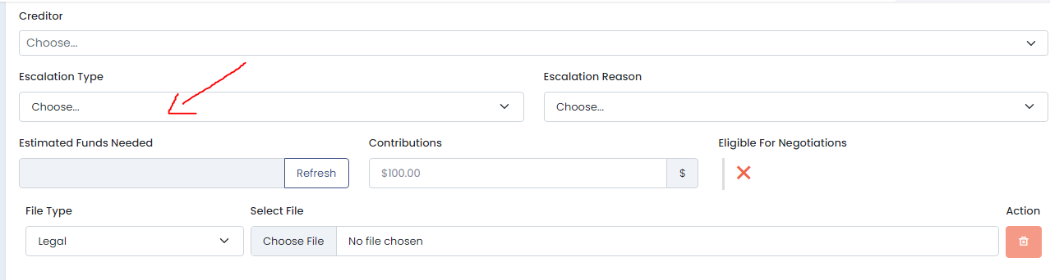
Special Draft
Why?
For us to assist on negotiations, we estimate the amount in need for us to expedite the process for negotiations.
Where can we check for the estimate amount needed?

Slide 8
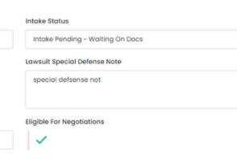
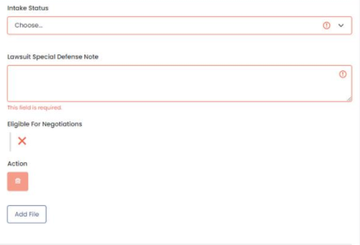
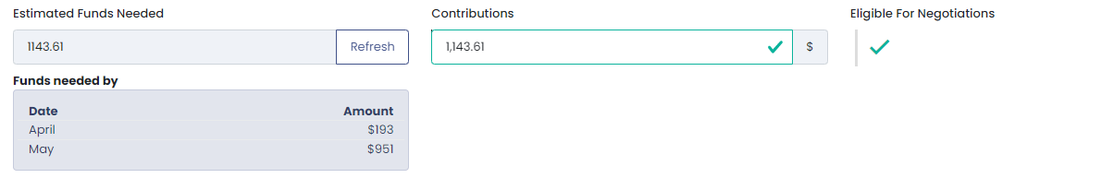


Account Eligible/Ineligible and Funds Needed
Creditor eligible to settle status
Green check mark - Negotiations team can settle the account can be settled with the creditor
Red X – Negotiations will not be able to work with the creditor to reach the best settlement. To find reasons why, please review negotiations notes and eligibility dates in client creditor list
Estimated Funds needed
Form will provide an estimate of the funds needed to settle along with estimated SD breakdown . If there are not enough funds in the calculator, advise the client how much they are willing to add.
If no funds needed, $1.00 in the "Contributions" box to be able to submit the form
Amount of funds needed to settle
Amount of funds the client can add
= Ineligible
= Eligible

Slide 9
Talking Points/Steps
Make the client comfortable with the conversation. Place the client’s mind an ease.
Review Legal Documents.
Ask questions for the client.
Open Intake Form and filled the information in need. (Date Received, Court Date, Legal Notes, etc)
“I understand Mr./Ms. Client this can be an overwhelming situation. Bare with me while I review the documents”
“When did you receive the documents?”

Slide 10
Talking Points/Steps
Ask client Special Draft. (Stressed the Importance of this)
Go based the “Estimated Fund Needed” Box
If the client agrees. Finalize any changes and complete Intake.
If the client denies or is unable to add additional
“As I checked, currently your funds are being utilized for current settlements, we need additional funds to set a payment arrangement with “x” creditor. Are you able to add additional funds?
“We will follow up once we have negotiated and have a settlement in place, our negotiator will follow up if anything else is needed from you. In addition, establish the additional funds once negotiations are done”
“We understand, if you change your mind please reach us as soon as possible, keep in mind this is time-sensitive. Fund are needed for us to secure the settlement.

Slide 11
Talking Points/Steps
Legal Advice
If enroll in Legal Protection
If not enroll in Legal Protection
“You are enroll in our Legal Protection BLP/American Legal Club will follow up with you to provide the next steps and answer any questions you may have”
“Unfortunately, we are not educated enough to provide or answer any question on what you can do next. We are not attorneys neither we can provide legal advice. Our best advice is to reach our to a local attorney for additional assistance. “
“We have some resources on your state we can share that you are able to use to reach for legal assistance. I can send you this link by email/text.”

